Slide 1
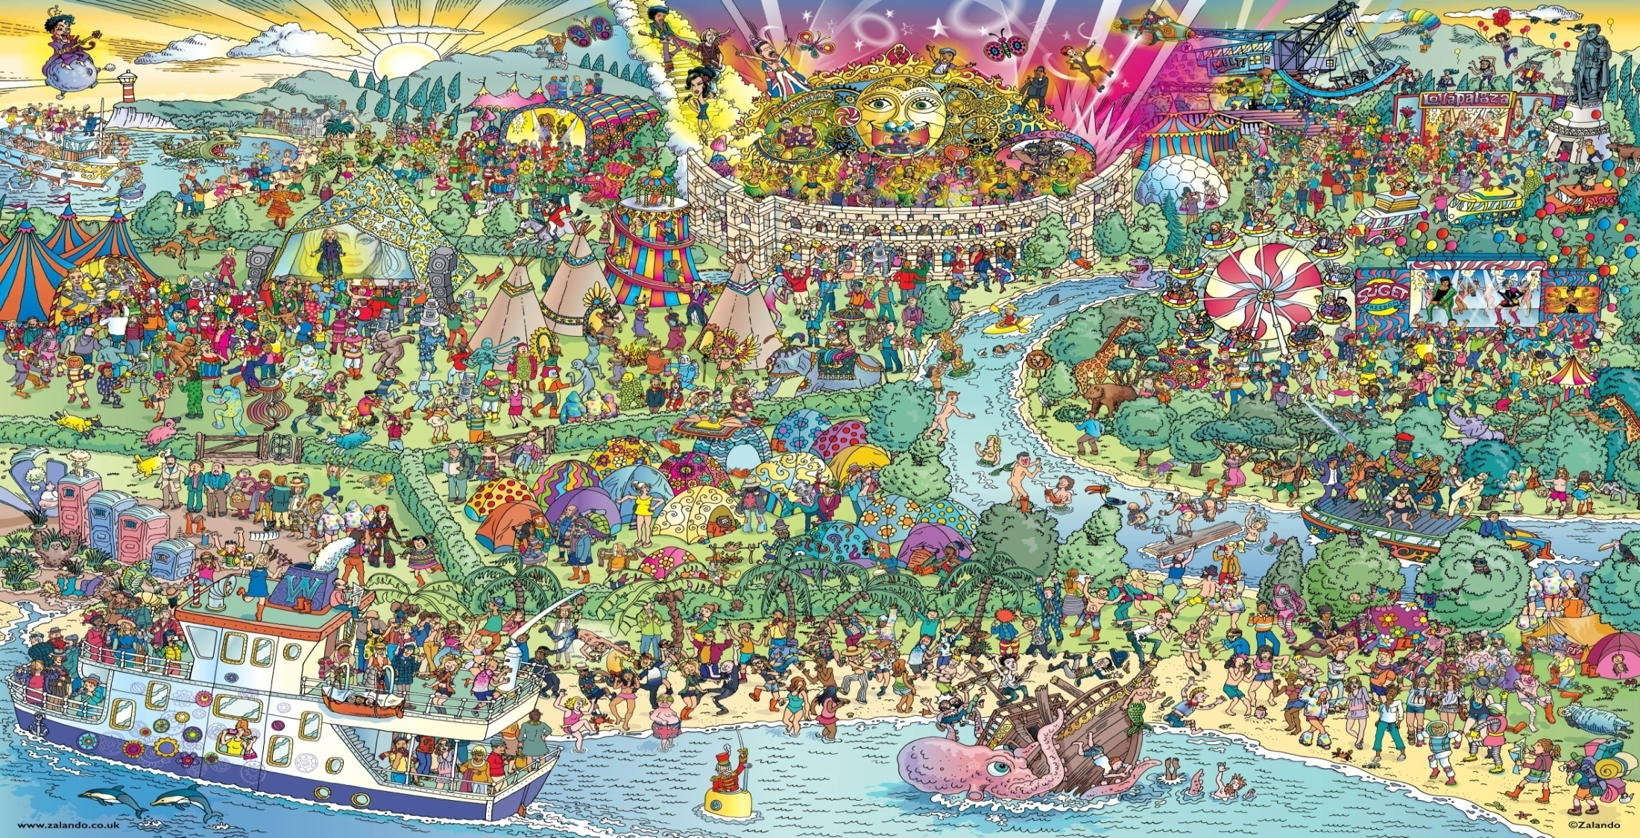
We will start at 5 past start time Send me student ID in private chat

Slide 2
Please log into ZOOM using your UTS student ID
Security purposes
It also avoids having to check the participants window every 5 min
https://www.uts.edu.au/current-students/managing-your-course/using-uts-systems/zoom

Slide 3
What have you guys been up to outside of work or uni ?
It’s important to keep your mind onto different things
It’s always when you are not thinking that the solution pops up in your head
So Discover
Even with the lock down

Slide 4
C++ vs Java
What do they have in common ?
What are their differences ?
C++ seems to have a lot more that you need to manage but I guess that means you have a lot more control

Slide 5
Learning
“I find it confusing and hard. It's so complicated.”
“What is it that you find complicated ?”
“All of it”
There is only so much that the staff can do

Slide 6
Break down the unknown into smaller manageable portions
Deal with those knowledge gaps
Relate what you have just learned to what you already know
Understand the differences and the limitations
Give yourself the time to put in the effort to reflect about what you’ve learned
Java
Items that are hard to remember will obviously require more effort to remember
So please make an effort
C++
pointers and references
delete and destruction
templates
.cpp and .h
Other stuff
Data structures
Nodes
Sequence Containers
Container Adaptors
Graphs and binary trees
Other stuff

Slide 7
How to learn
The first step is to identify your knowledge gap
It’s easier to remember what was forgotten
so forget and do revisions
Remember
(Revisions)
Identify Knowledge Gap
Communicate
(talk with others about it)
Research
(acquire knowledge from other sources)
Join the Discord groups for DSA, FEIT and ProgSoc
Who do you talk to about DSA or C++?
Other knowledge sources can give you other perspectives
What other sources are you using ?

Slide 8
Week 5
Stack
Revision
Queue
Binary Search
Iteration
Recursion

Slide 9
Assignment 1
“They must either demonstrate/explain their assignments to their tutors via online meeting or submit a 5-minute video clip online”
How are YOU going to do that ?
Each video clip must be a
minimum of 4 minutes
and a maximum of 6 minutes.
Remember: reflection = time && effort.
If everyone does 8 min
this scales up really quickly

